Slide 1
Bayesian networks
Thuc Le
Advanced Analytic Techniques 2
University of South Australia
(The slides are based on Neapolitan’s books)

Slide 2
Outline
Correlation vs Causation – Observation vs Intervention
Causal inference
Local structure learning
PC simple
HITON PC
Cohort study
Summary

Slide 3
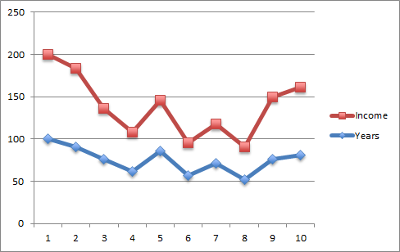
Correlation v causation
Participant | Years of education | Income ($1000)
1 | 21 | 75
2 | 19 | 70
3 | 16 | 45
4 | 13 | 35
5 | 18 | 45
6 | 12 | 29
7 | 15 | 35
8 | 11 | 29
9 | 16 | 55
10 | 17 | 60
???
Edu
Inc
People with more years of education tend to have higher incomes.
People with fewer years of education tend to have lower income.
Correlation is not Causation!
Pearson correlation coefficent =0.91

Slide 4
Simpson’s Paradox [Pearl, 2000]
 | Recovered | Not recovered | Sum | Recover rate
Drug | 20 | 20 | 40 | 50%
No Drug | 16 | 24 | 40 | 40%
 | 36 | 44 | 80
Female | Recovered | Not recovered | Sum | Recover rate
Drug | 2 | 8 | 10 | 20%
No Drug | 9 | 21 | 30 | 30%
 | 11 | 29 | 40
Male | Recovered | Not recovered | Sum | Recover rate
Drug | 18 | 12 | 30 | 60%
No Drug | 7 | 3 | 10 | 70%
 | 25 | 15 | 40

Slide 5
Causality - definitions
X causes Y iff there is some manipulation of X leading to a change in the probability distribution of Y. (Judea Pearl, 2000; Neapolitan, 2003)

Slide 6
How to discover causality?
The gold standard method:
A randomized controlled experiment (RCE)
Education duration causes income level
Bachelor (16 years)
PhD (20 years)
60K
80K
100 people
Male
Same background
…
100 people
Male
Same background
…

Slide 7
How to discover causality?
The gold standard method:
A randomized controlled experiment (RCE)
Smoking causes lung cancer
Smoking
Non-smoking
7/10
2/10
10 people
Male
Same blood type
…
10 people
Male
Same blood type
…
5 years later

Slide 8
Randomised controlled experiment
The gold standard method:
A randomised controlled experiment (RCE)
Infeasible
Unethical
Expensive

Slide 9
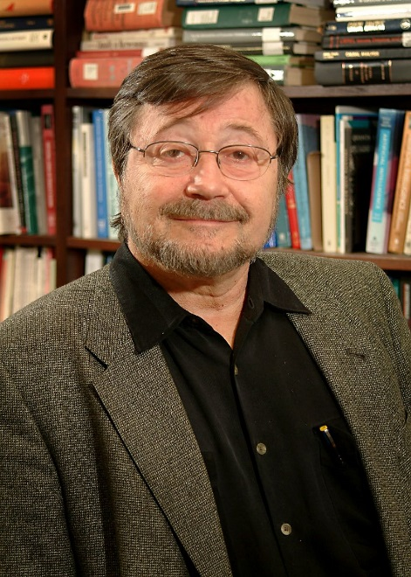
Judea Pearl
JUDEA PEARL WINS ACM TURING AWARD FOR CONTRIBUTIONS THAT TRANSFORMED ARTIFICIAL INTELLIGENCE
Developed Novel Framework for Reasoning under Uncertainty that Changed How Scientists Approach Real World Problems
NEW YORK, March 15, 2012– ACM, the Association for Computing Machinery www.acm.org today named Judea Pearl of the University of California, Los Angeles the winner of the 2011 ACM A.M. Turing Award for innovations that enabled remarkable advances in the partnership between humans and machines that is the foundation of Artificial Intelligence (AI) www.acm.org/pearl.
The ACM Turing Award, widely considered the "Nobel Prize in Computing," carries a $250,000 prize, with financial support provided by Intel Corporation and Google Inc. It is named for the British mathematician Alan M. Turing, whose 100th anniversary will be celebrated in June at the ACM 2012 Turing Centenary Celebration http://turing100.acm.org that includes 34 past Turing Award winners along with Pearl.
Pearl’s work on reasoning with uncertainty as well as his game˗changing contributions to machine reasoning about causality have had a pervasive influence not only on machine learning but on natural language processing, computer vision, robotics, computational biology, econometrics, cognitive science, and statistics," Cerf said.

Slide 10
Causal Effect – Judea Pearl
+1
do-calculus
+0.8
X₁ | X₂ | … | X_{n-1} | X_{n}
5.2 | 7.5 |  | 6.5 | 5.2
5.6 | 7.2 |  | 6.6 | 5.3
… | … | … | … | …
5.4 | 7.1 |  | 7.1 | 5.7
5.7 | 6.9 |  | 6.9 | 5.8
CausalEffect(X1→Xn)

Slide 11
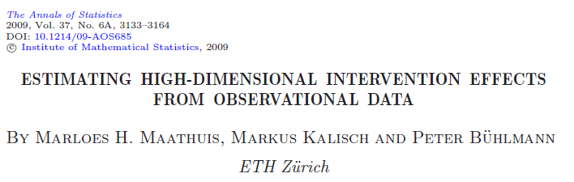
IDA method
(Intervention calculus when the DAG is Absent)
Use the PC algorithm to learn the CPDAG
Infer the causal effects, e.g. eff(X2, Y), in all DAGs in the equivalent class
Find the lower bound of causal effects.

Slide 12
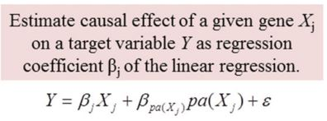
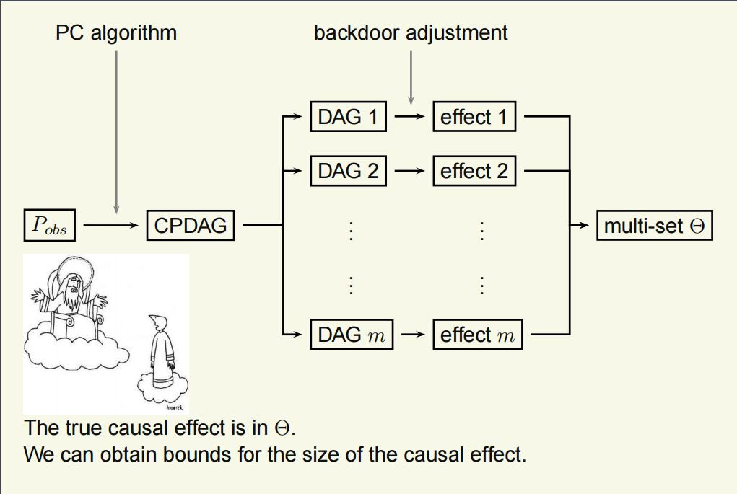
Causal inference - IDA

Slide 13
Local structure learning algorithms
A major weakness of PC algorithm
Time complexity is exponential to the number of variables.
Fix a variable and find parent and child nodes of the node.
Both PC-Simple and Hiton-PC have polynomial time complexity with the number of variables.

Slide 14
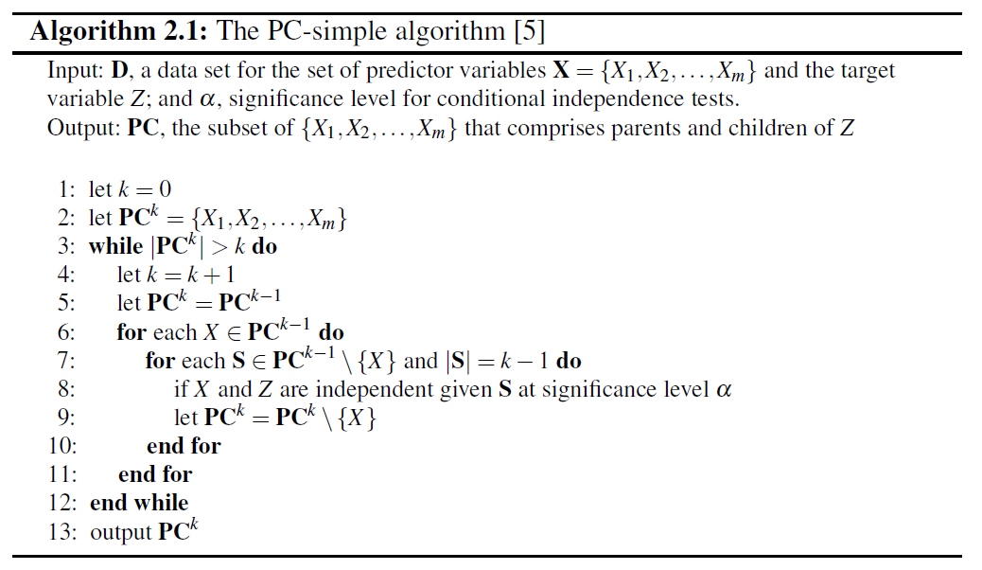
PC-simple = pcSelect

Slide 15





PC-Simple – an example
Let the Z be the target
H, D and E are independent of Z
G is independent of Z given F.
A is independent of Z given {B, C}.
, the program is terminated.

Slide 16
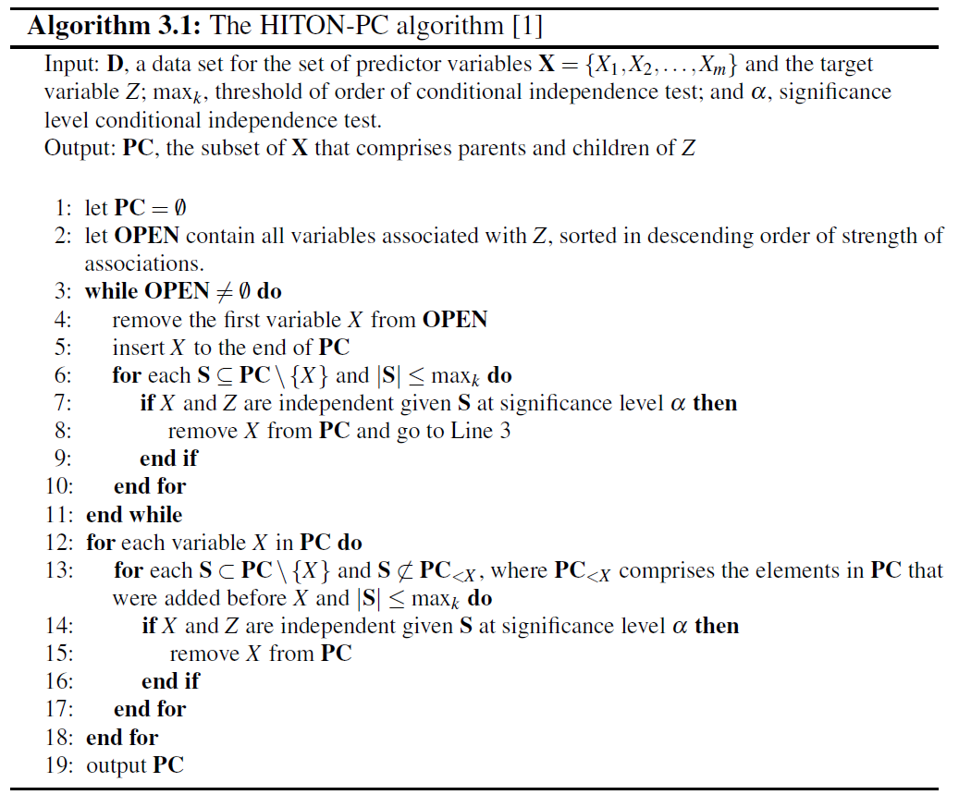
Hiton PC

Slide 17







HITON-PC – an example
Let Z be the fixed target and = 2
The first iteration
The second iteration
The third iteration
A is removed from the PC list since A is independent of Z given {B, C}
The fourth iteration
The fifth iteration

Slide 18

HITON-PC – an example 2
Pruning the current PC list.
G is removed sine G is independent of Z given F
The final PC list.

Slide 19
Cohort study 1
Defined population
Expose
Not expose
Have
a disease
Not have
a disease
Have a
disease
Not have
a disease
Prospective: follow up.
Retrospective: look back. Historic study.

Slide 20
Cohort study 2
Cohorts: share common characteristics but exposed or not exposed.
Determine how the exposure causes an outcome.
Measure: odds ratio = (a/b) / (c/d)
 | Diseased | Healthy
Exposed | a | b
Not exposed | c | d

Slide 21
Limitations of cohort study
Need to know a hypothesis beforehand
Domain experts determine the control variables.
Collect data and test the hypothesis.
Not for data exploration.
We need
Given a data set without any hypotheses.
An automatic method to find and validate hypotheses.
For data exploration.

Slide 22
Matches
Exact matching
Exact matches on all covariates. Infeasible.
Limited exact matching
Exact matches on a few key covariates.
Nearest neighbour matching
Find the closest neighbours
Propensity score matching
Based on the predicted probability of being selected to the treatment based on covariates.
Notes:
A propensity score is the probability of a unit (e.g., person, classroom, school) being assigned to a particular treatment given a set of observed covariates. Propensity scores are used to reduce selection bias by equating groups based on these covariates.
Suppose that we have a binary treatment T, an outcome Y, and background variables X. The propensity score is defined as the conditional probability of treatment given background variables:

Slide 23
Method1
Discover causal association rules from large databases of binary variables
A | B | C | D | E | F | Y
1 | 1 | 1 | 1 | 1 | 1 | 1
1 | 0 | 1 | 1 | 1 | 1 | 1
1 | 1 | 0 | 1 | 0 | 1 | 1
0 | 1 | 1 | 1 | 1 | 1 | 1
0 | 1 | 0 | 0 | 0 | 0 | 0
0 | 0 | 0 | 0 | 1 | 0 | 1
1 | 0 | 0 | 0 | 0 | 1 | 0
1 | 0 | 1 | 1 | 1 | 0 | 0
0 | 1 | 0 | 1 | 1 | 0 | 0
0 | 1 | 0 | 0 | 1 | 0 | 0
A → Y
A | B | C | D | E | F | Y
1 | 1 | 1 | 1 | 1 | 1 | 1
1 | 0 | 1 | 0 | 1 | 1 | 1
1 | 1 | 0 | 1 | 0 | 1 | 0
1 | 0 | 1 | 0 | 1 | 0 | 0
0 | 1 | 1 | 1 | 1 | 1 | 0
0 | 0 | 1 | 0 | 1 | 1 | 0
0 | 1 | 0 | 1 | 0 | 1 | 1
0 | 0 | 1 | 0 | 1 | 0 | 1
Fair dataset

Slide 24
Methods
A: Exposure variable
{B,C,D,E,F}: control variable set.
Rows with the same color for the control variable set are called matched record pairs.
Fair dataset
A | B | C | D | E | F | Y
1 | 1 | 1 | 1 | 1 | 1 | 1
1 | 0 | 1 | 0 | 1 | 1 | 1
1 | 1 | 0 | 1 | 0 | 1 | 0
1 | 0 | 1 | 0 | 1 | 0 | 0
0 | 1 | 1 | 1 | 1 | 1 | 0
0 | 0 | 1 | 0 | 1 | 1 | 0
0 | 1 | 0 | 1 | 0 | 1 | 1
0 | 0 | 1 | 0 | 1 | 0 | 1
 | A=0
A=1 | Y=1 | Y=0
Y=1 | n₁₁ | n₁₂
Y=0 | n₂₁ | n₂₂
An association rule is a causal association rule if:
A → Y

Slide 25
Algorithm
x
x
A | B | C | D | E | Y
1 | 1 | 1 | 1 | 1 | 1
… | … |  |  |  | …
0 | 1 | 1 | 1 | 1 | 0
… |  |  |  |  | …
A | B | C | D | E | F | G | Y
1 | 1 | 1 | 1 | 1 | 1 | 0 | 1
… | … |  |  |  |  |  | …
1 | 1 | 0 | 1 | 0 | 1 | 0 | 1
Find candidate exposure variables using association rule mining
For each association rule (e. g. )
A → Y
Find the exclusive variables of the exposure variable (support, association), i.e. G, F.
The control variable set = {B, C, D, E}.
3. Find the fair dataset. Search for all matched record pairs
4. Calculate the odds-ratio to identify if the testing rule is causal
5. Repeat 2-4 for each variable which is the combination of variables. Only consider combination of non-causal factors.

Slide 26
Summary
Causal inference
RCE
IDA algorithm
Local causal structure learning
PC-simple
HITON PC
Cohort study
Next week, text mining and LDA

Slide 27
Practical approaches to causal relationship exploration
http://nugget.unisa.edu.au/Causalbook/
J. Li, T. Le, J. Liu, J. Liu, J. Zhou, B. Sun, and S. Ma, From Observational Studies to Causal Rule Mining , ACM Transactions on Intelligent Systems and Technology, 2015.

Slide 28
Thank You.

